Slide 1
FRAUD DETECTION FOR FINANCIAL RISK MANAGEMENT
RAJA PERUGU
WSU ID : F837G868

Slide 2
Previous Week
Understood dataset structure and attributes
Inspected data types and data quality
Checked for missing values and duplicates
Performed basic statistical analysis
Analyzed isFraud class imbalance
Analyzed transaction types and their fraud rates

Slide 3
Fraud Detection Basics
Reference: Dal Pozzolo et al. (2015), “Calibrating Probability with Undersampling for Unbalanced Classification.”
Fraud data is highly imbalanced — fraudulent transactions are rare compared to legitimate transactions.
(0.129% fraud vs. 99.871% legitimate.)
Accuracy can be misleading when fraud is rare, so the minority fraud class needs special attention.
(A model could classify almost everything as legitimate and still achieve very high accuracy while missing fraud.)
Undersampling : can reduce the large legitimate class and help the model learn fraud patterns more effectively.
(Our dataset has 6.35M legitimate transactions vs. 8,213 fraud transactions, so the legitimate class could be reduced during training.)
However, undersampling changes the original class distribution, which can make the model's predicted fraud probabilities unreliable.
To address this, Dal Pozzolo et al. introduce probability calibration, which adjusts the model's probabilities to account for the changed class distribution. The paper also shows why the classification threshold can be adjusted depending on the cost of different errors.
We can use these ideas when building our fraud models by testing undersampling on the training data, calibrating the resulting probabilities, and selecting a suitable fraud threshold instead of simply using the default 0.5 cutoff

Slide 4
Class weighting: Keep the training data intact while assigning greater importance to fraud during model training.
Performance evaluation:Apply these strategies to our Machine Learning models and Compare the resulting models using Precision, Recall, F1-score, AUPRC, and the Confusion Matrix.
Ref : This approach is guided by He & Garcia (2009) and Dal Pozzolo et al. (2015).
Precision: Of the transactions we flag as fraud, how many are actually fraud?
Recall: Of all actual fraud transactions, how many did we successfully detect?
F1-score: A balance between Precision and Recall.
AUPRC: Measures how well the model identifies fraud across different classification thresholds, focusing on the rare fraud class.
Confusion Matrix: Shows correct and incorrect predictions — fraud detected, fraud missed, legitimate correctly identified, and legitimate incorrectly flagged.

Slide 5
Random Forest & XGBoost
Why these models?
We chose Random Forest because our dataset is tabular transaction data with potentially complex relationships between features. Random Forest combines multiple decision trees to learn these patterns more robustly. (Ref..:Breiman, L. (2001). Random forests. Machine Learning), which provides the foundation for the Random Forest approach.
Random Forest:
Combines multiple randomized decision trees to learn patterns that distinguish fraudulent and legitimate transactions.
XGBoost:
Uses a different tree-based boosting approach, building trees sequentially to improve previous errors. This allows us to compare two different ensemble methods for our fraud-detection problem.(Ref… : Chen, T., & Guestrin, C. (2016). XGBoost: A scalable tree boosting system. KDD, 2016.)

Slide 6
Explainability : SHAP
Our fraud models can identify a transaction as fraudulent, but we also need to understand why the model made that prediction.
What is SHAP?
SHAP (SHapley Additive exPlanations) is an explainability method based on Shapley values that determines how individual features contribute to a model's prediction.
SHAP can show which transaction features push a prediction toward fraud or toward legitimate.
For a specific transaction, SHAP can show which features contributed most to its fraud prediction.
By examining SHAP values across many transactions, we can identify which features are generally most influential in the model's fraud predictions.

Slide 7
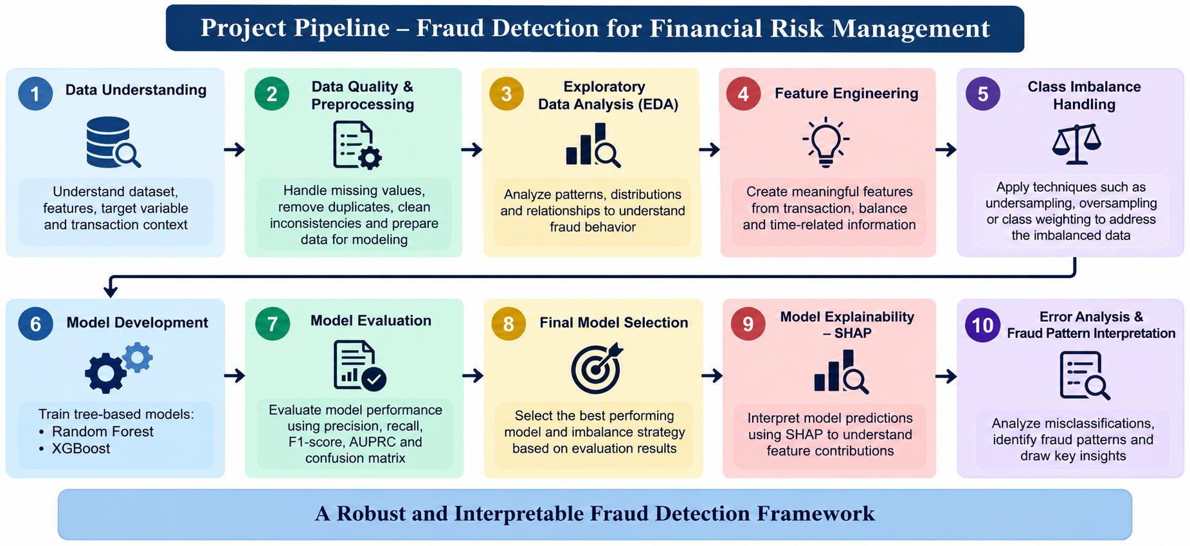

Slide 8
NEXT week:
EDA on the fraud detection dataset
Create EDA visualizations
Analyze fraud vs. legitimate transaction patterns
Identify useful features for feature engineering
Begin feature engineering
Document initial findings

Slide 9
PREVIOUS WEEK
Loaded and understood the 6.36M-row transaction dataset
Checked data types, missing values and duplicates
Measured severe class imbalance: 0.129% fraud
Analyzed transaction types and initial fraud rates

Slide 10
THIS WEEK TASKS(WEEK -3) :
Transaction amount analysis
Sender and receiver balance behavior
Fraud-rate behavior across time steps
Numerical feature relationship analysis

Slide 11
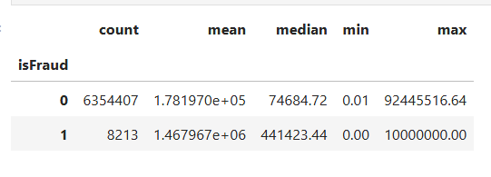
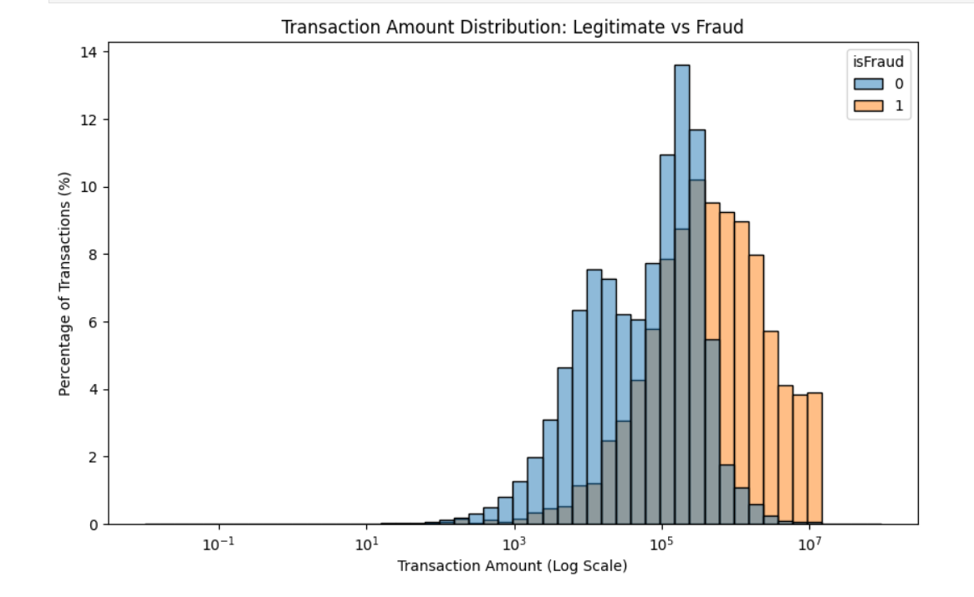
Transaction amount analysis
INTERPRETATION :
Fraudulent transactions tend to involve much larger amounts.
Amount distributions overlap, so amount alone cannot identify fraud.

Slide 12
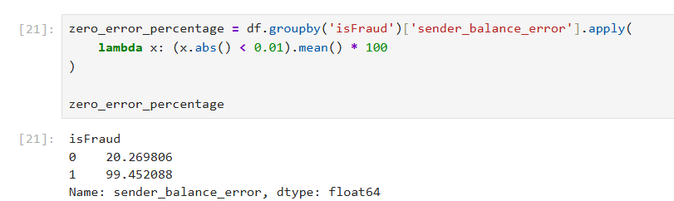
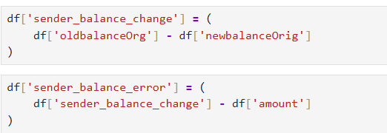
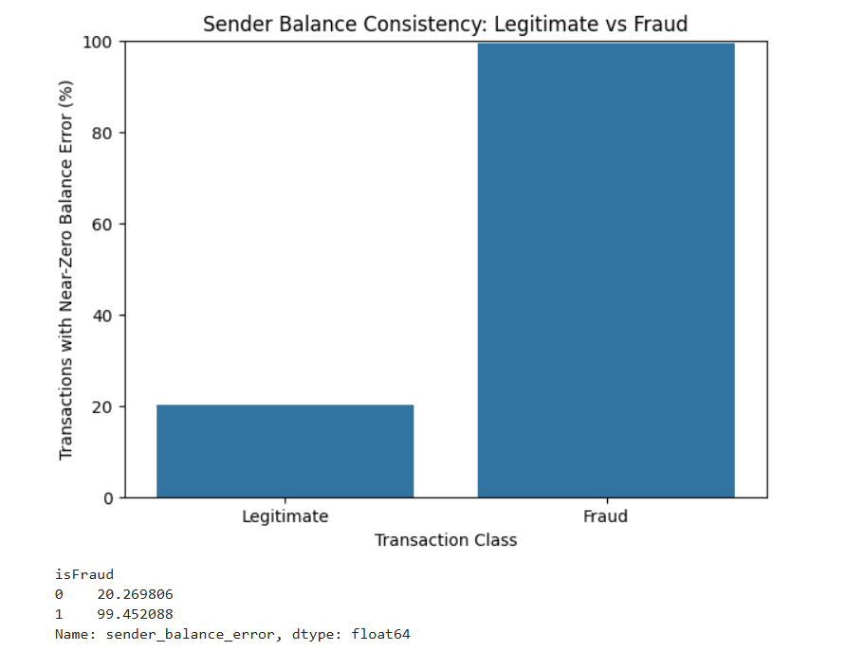
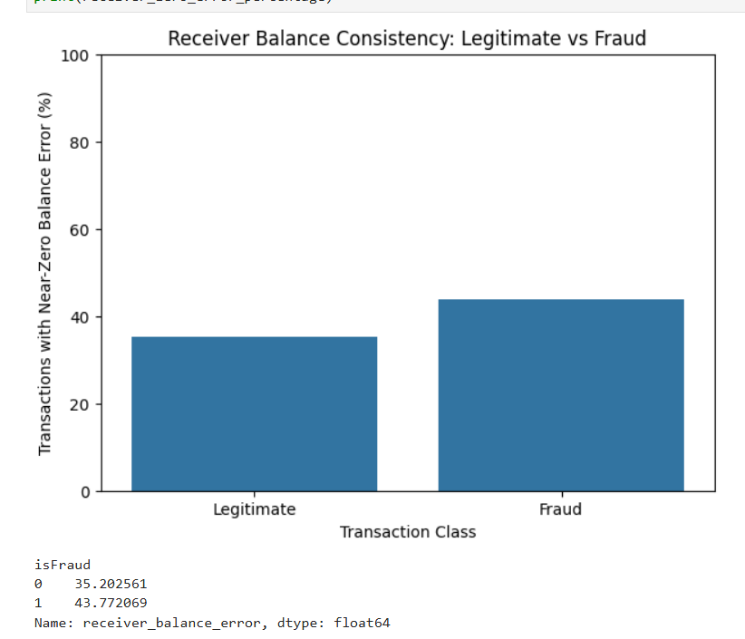
Sender and receiver balance behavior

Slide 13
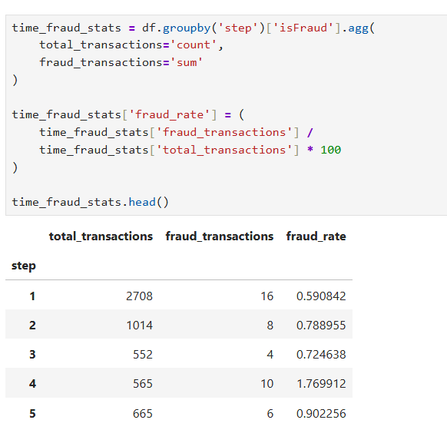
Fraud-rate behavior across time steps

Slide 14
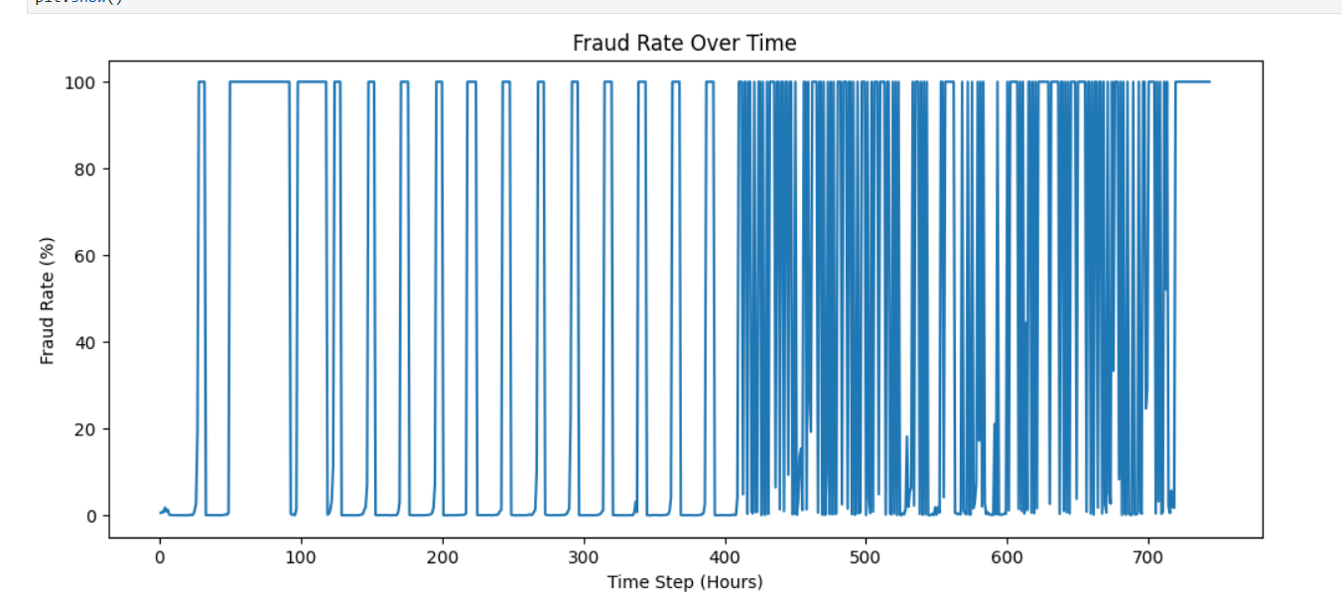
Fraud rates vary significantly across time steps, with several sharp spikes, especially in later periods.
However, these spikes may be influenced by low transaction volume in some hours, so they do not necessarily mean fraud steadily increases over time

Slide 15
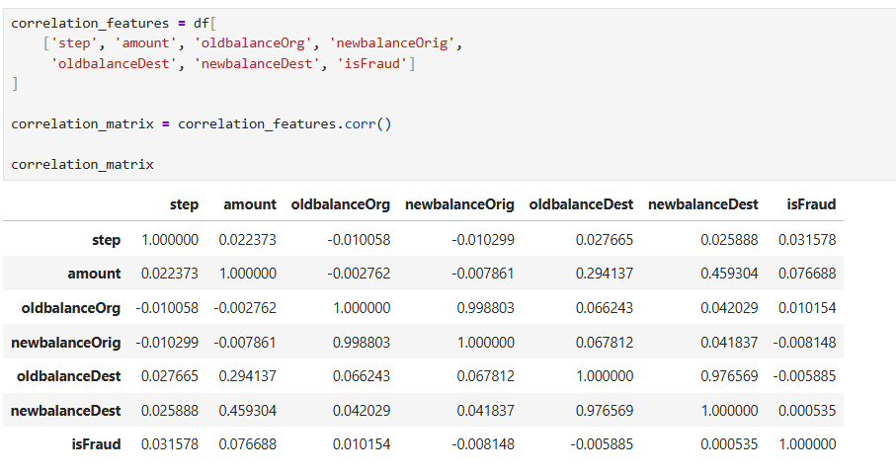
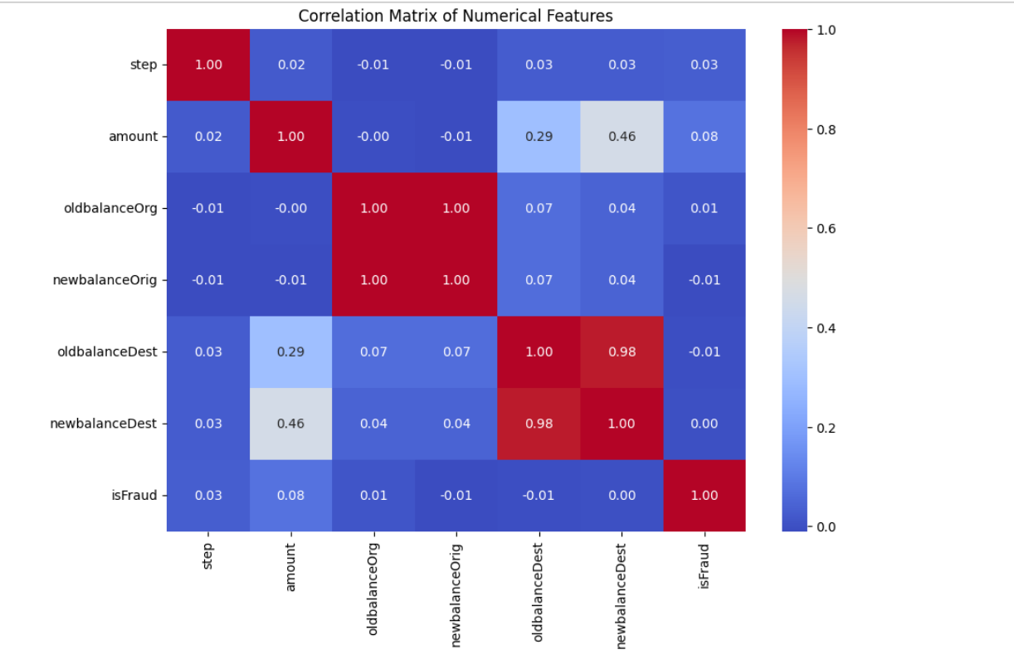
Numerical feature relationship analysis
Most original numerical features have weak linear correlation with fraud.amount is the highest at only about 0.08.The strong correlations are mainly between related balance fields, suggesting engineered features and nonlinear models may capture fraud patterns better.

Slide 16
NEXT WEEK(WEEK -4 )
Begin feature engineering based on EDA findings
Encode categorical transaction features
Create selected balance/time-based features
Prepare the dataset for imbalance handling and modeling

Slide 17
PREVIOUS WEEK
Completed Exploratory Data Analysis (EDA)
Identified key fraud patterns from amount, type, balance, and time analysis
Found strong sender-balance consistency signal
Prepared EDA findings for feature engineering

Slide 18
THIS WEEK (WEEK-4)
Created engineered features based on EDA findings
Encoded categorical transaction type features
Finalized a clean 14-feature modeling dataset
Reviewed classification metrics, formulas, and fraud interpretation

Slide 19
Evaluation Metrics - Confusion Matrix
Actual / Predicted | Predicted Fraud | Predicted Legitimate
Actual Fraud | True Positive (TP) | False Negative (FN)
Actual Legitimate | False Positive (FP) | True Negative (TN)
Positive = Fraud
Negative = Legitimate

Slide 20
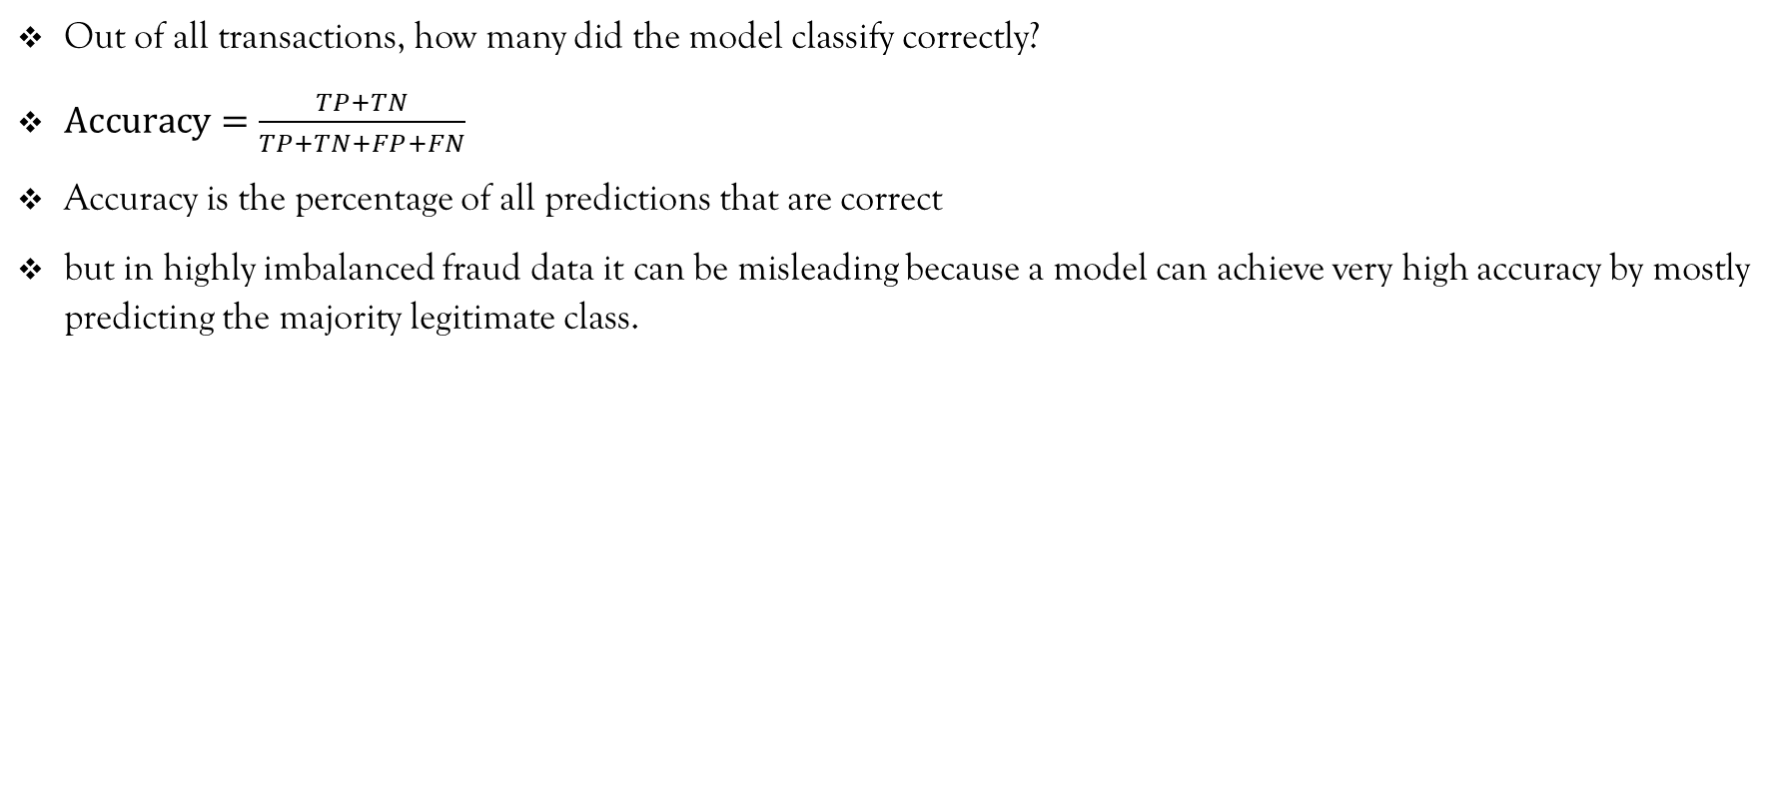
Accuracy
Out of all transactions, how many did the model classify correctly?
$\text{Accuracy}=\frac{TP+TN}{TP+TN+FP+FN}$
Accuracy is the percentage of all predictions that are correct
but in highly imbalanced fraud data it can be misleading because a model can achieve very high accuracy by mostly predicting the majority legitimate class.

Slide 21
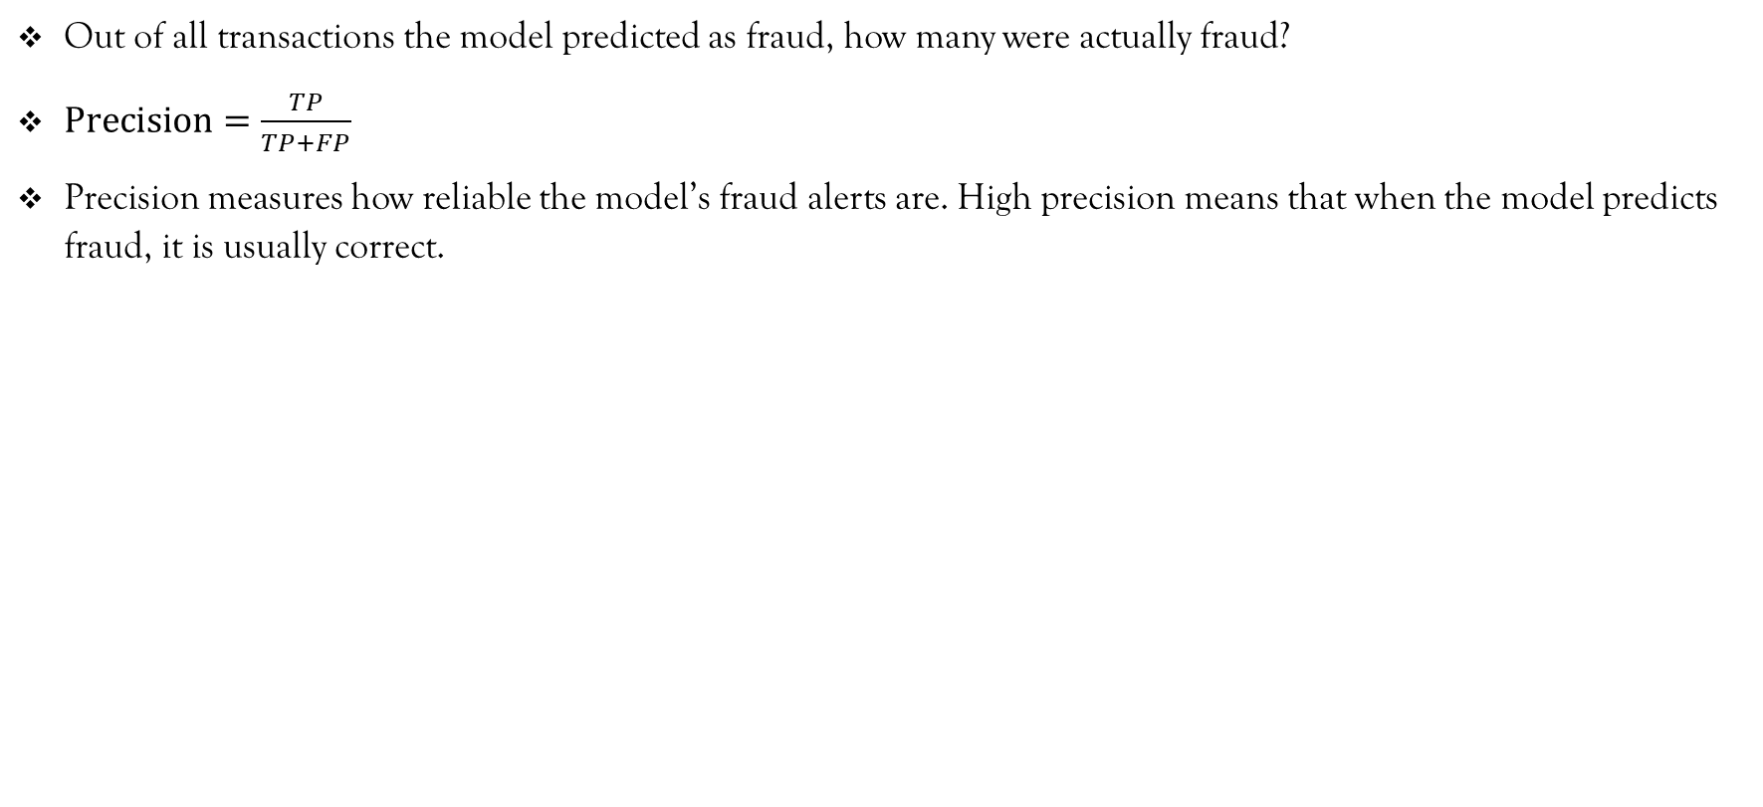
Precision.
Out of all transactions the model predicted as fraud, how many were actually fraud?
$\text{Precision}=\frac{TP}{TP+FP}$
Precision measures how reliable the model’s fraud alerts are. High precision means that when the model predicts fraud, it is usually correct.

Slide 22
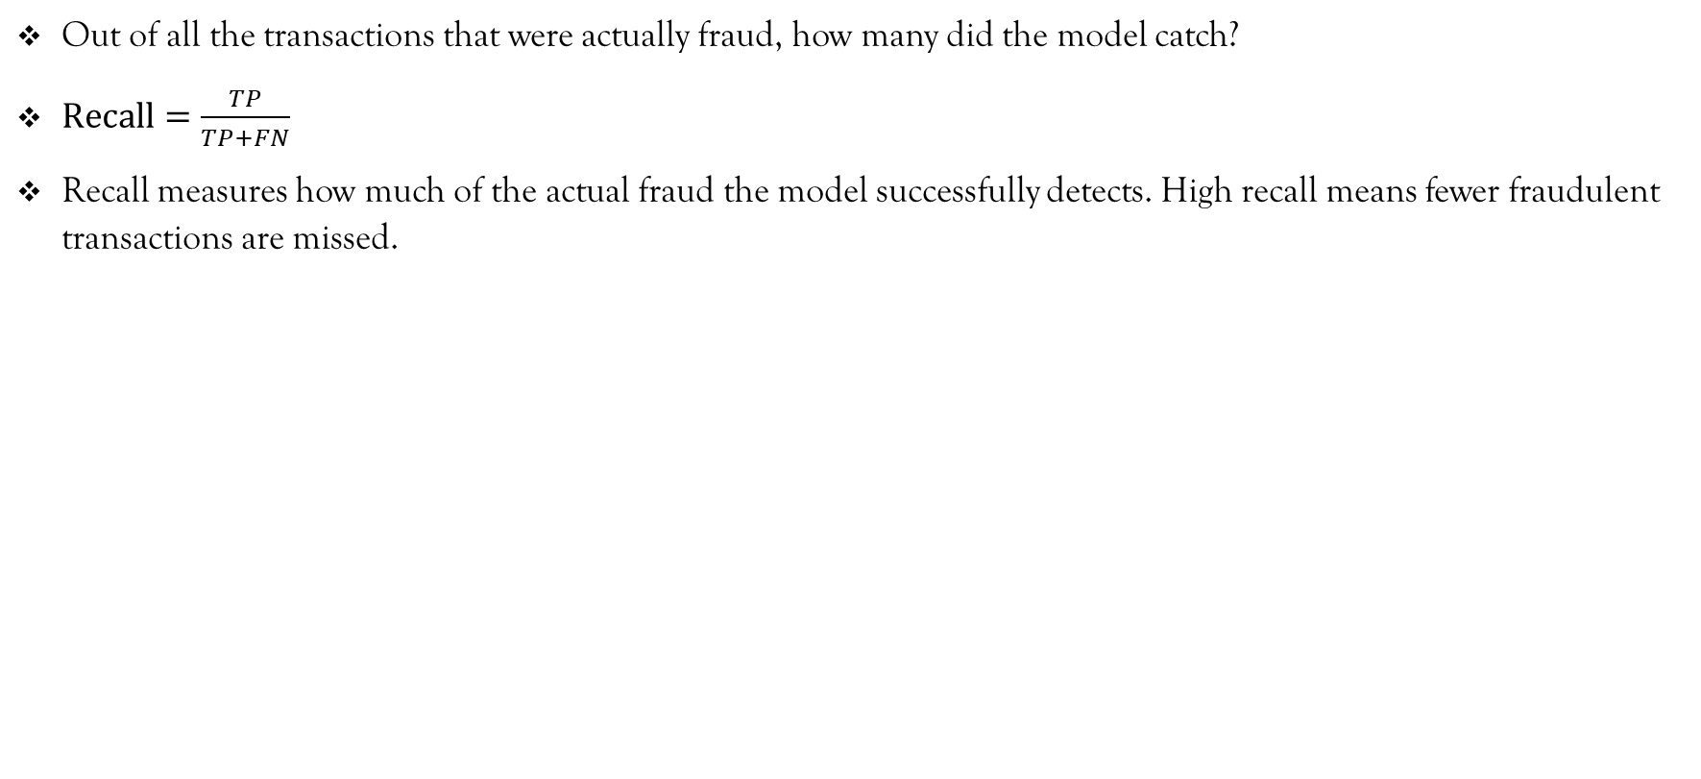
Recall
Out of all the transactions that were actually fraud, how many did the model catch?
$\text{Recall}=\frac{TP}{TP+FN}$
Recall measures how much of the actual fraud the model successfully detects. High recall means fewer fraudulent transactions are missed.

Slide 23
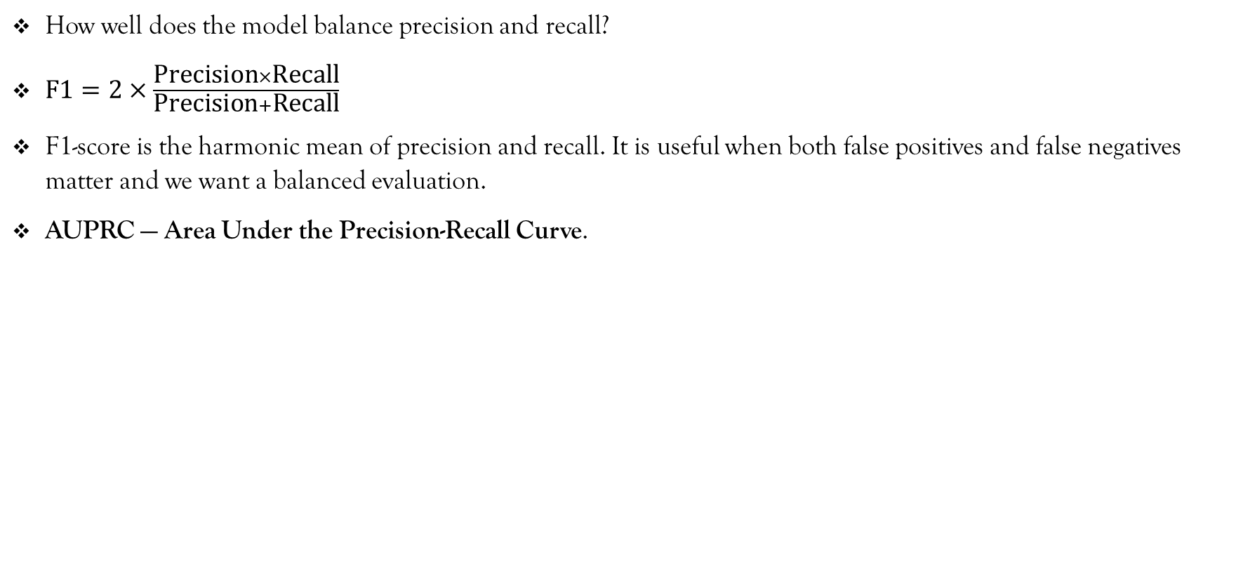
F1-SCORE
How well does the model balance precision and recall?
$\text{F1}=2×\frac{\text{Precision}×\text{Recall}}{\text{Precision}+\text{Recall}}$
F1-score is the harmonic mean of precision and recall. It is useful when both false positives and false negatives matter and we want a balanced evaluation.
AUPRC — Area Under the Precision-Recall Curve.

Slide 24
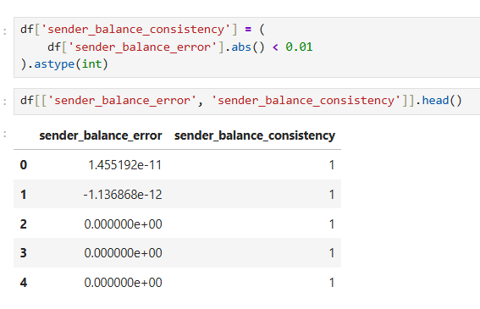
CREATED FEATURES:sender balance consistency

Slide 25
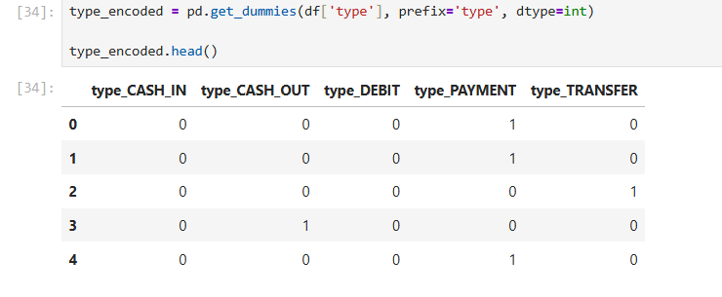
encoded the `type` column into numerical transaction-type features.

Slide 26
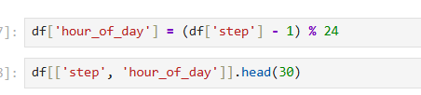
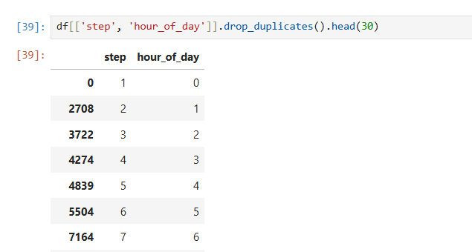
CREATED FEATURES: HOUR OF THE DAY

Slide 27
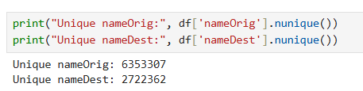
EXCLUDED VARIABLES
We Do not use the raw nameOrig and nameDest IDs directly as model features,we can still keep them temporarily in the dataframe because later, if we want, we can derive behavioral features from them

Slide 28
Feature Engineering Summary
amount and balance columns → keep
sender_balance_error → keep
sender_balance_consistency → keep
encoded type_ columns → keep
step → keep
hour_of_day → keep
nameOrig, nameDest → exclude as raw IDs
original text type → exclude after encoding
isFlaggedFraud → keep only for baseline comparison
isFraud → target, not input

Slide 29
PREVIOUS WEEK(WEEK-4)
Created engineered features based on EDA findings
Encoded categorical transaction type features
Finalized a clean 14-feature modeling dataset
Reviewed classification metrics, formulas, and fraud interpretation

Slide 30
THIS week (week-5)
Split data into training and testing sets
Apply imbalance methods only to the training data
Test undersampling, oversampling and class weighting
Prepare balanced training versions for modeling

Slide 31
TASKS DONE :
Created stratified 80/20 train-test split
Tested class weighting, random undersampling and random oversampling
Evaluated each method with the same Logistic Regression baseline
Compared precision, recall, F1, AUPRC and error counts

Slide 32
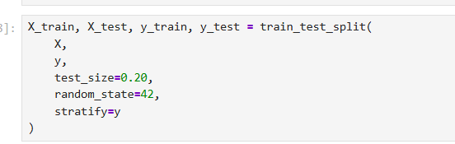
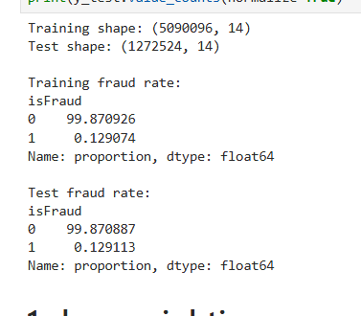
SPLITTING THE DATA WITH IMBALNCE HANDLING
We split the dataset into 80% training data and 20% testing data using stratification, so both sets keep nearly the same fraud-to-legitimate ratio as the original dataset.
The training set is used for imbalance handling and model learning, while the test set remains untouched for fair evaluation

Slide 33
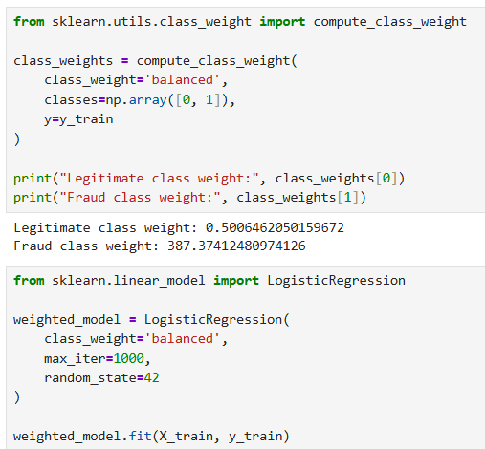
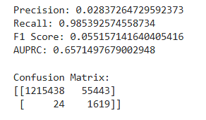
CLASS WEIGHTING
We keep the full training dataset unchanged, but give the rare fraud class a much higher weight so the model pays more attention to fraud during training.
This helps reduce the chance that the model ignores fraud just because legitimate transactions are far more common.
Class weighting achieved extremely high recall of 98.54%, detecting 1,619 of 1,643 fraud cases. However, precision was only 2.84% because 55,443 legitimate transactions were falsely flagged as fraud.
This shows that class weighting strongly improves fraud detection but produces too many false positives at the default threshold.

Slide 34
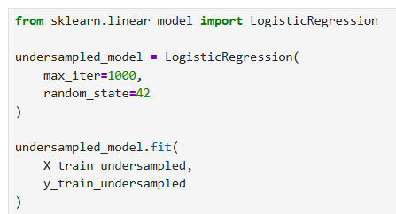
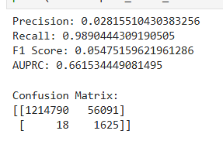
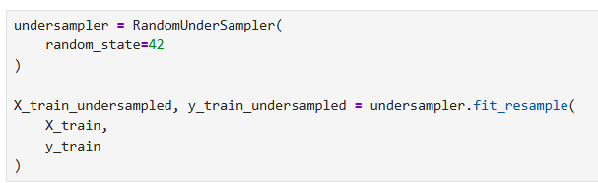
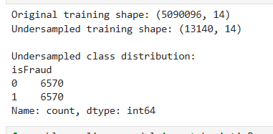
RANDOM UNDERSAMPLING
We reduce the very large legitimate class by randomly keeping only a smaller sample of legitimate transactions while keeping all fraud cases.
This creates a balanced training set so the model can learn fraud patterns without being dominated by the majority class.
Undersampling achieved the highest recall at 98.90%, catching 1,625 fraud cases and missing only 18.However, precision remained very low at 2.82% because it still produced 56,091 false positives.
So it was excellent at catching fraud, but it did not solve the false-alarm problem.

Slide 35
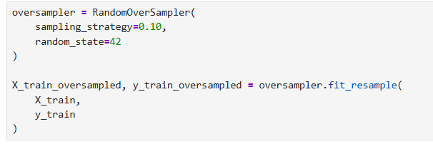
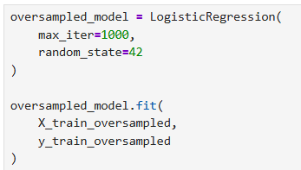
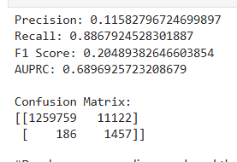
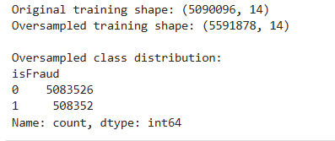
RANDOM OVERSAMPLING
We keep all legitimate transactions and increase the number of fraud examples by randomly duplicating existing fraud cases in the training data.
This gives the model more exposure to the minority fraud class without removing any legitimate data.
Oversampling improved the overall balance of the model, increasing precision to 11.58%, F1-score to 20.49%, and AUPRC to 68.97%.
It also reduced false positives dramatically to 11,122, although recall dropped to 88.68%, meaning more fraud cases were missed than with the other methods.

Slide 36
FINAL RESULT & COMPARISON
Method | Precision | Recall | F1 | AUPRC
Class Weighting | 2.84% | 98.54% | 5.52% | 65.71%
Undersampling | 2.82% | 98.90% | 5.48% | 66.15%
Oversampling | 11.58% | 88.68% | 20.49% | 68.97%
Class weighting and undersampling achieved very high recall
However, both produced too many false positives
Oversampling gave the best overall trade-off
Therefore, oversampling is the strongest candidate for the next modeling stage

Slide 37
NEXT WEEKS(WEEK-6)
Train Random Forest
Train XGBoost
Use the oversampled training set as the starting strategy
Compare both models using precision, recall, F1, AUPRC, and confusion matrix

Slide 38
PREVIOUS WEEK
Created stratified 80/20 train-test split
Tested class weighting, random undersampling and random oversampling
Evaluated all imbalance methods using the same Logistic Regression baseline
Selected random oversampling as the strongest overall candidate

Slide 39
THIS WEEK(WEEK-6)
Train Random Forest on the oversampled training data
Train XGBoost using the same features and training data
Evaluate both models using Precision, Recall, F1-score, AUPRC and Confusion Matrix
Compare the models and identify the current leading model

Slide 40
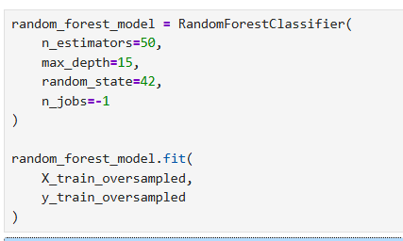
RANDOM FOREST MODEL DEVELOPMENT
Used the oversampled training data with all 14 predictor features.
Built 50 decision trees and limited each tree to a maximum depth of 15.
Why these settings? 50 trees provide a practical baseline, while depth 15 gives enough complexity without letting each tree grow without limit
Random Forest combines predictions from many trees to make the final fraud decision.

Slide 41
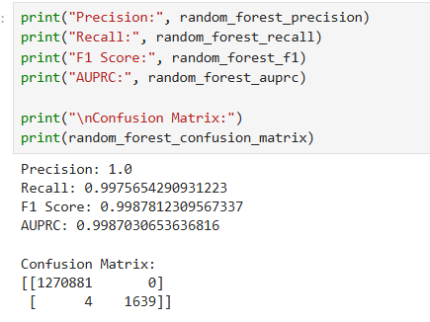
RANDOM FOREST RESULTS
Random Forest detected 1,639 of 1,643 fraud cases and produced zero false positives.
Its AUPRC of 0.9987 greatly exceeds the project target of 0.75.
Current result: extremely strong fraud detection with only 4 missed fraud cases.

Slide 42
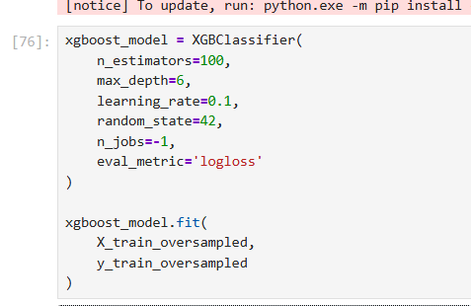
XGBOOST MODEL DEVELOPMENT
Used the same oversampled training data and the same 14 features for a fair comparison.
Built 100 boosted trees with maximum depth 6 and learning rate 0.1.
Each new tree tries to correct the errors made by the previous trees.

Slide 43
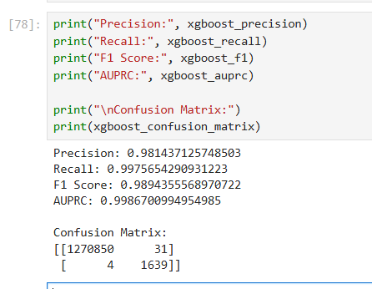
XGBOOST RESULTS
XGBoost also detected 1,639 of 1,643 fraud cases and missed only 4.
It produced 31 false positives, while its AUPRC of 0.9987 also greatly exceeded the 0.75 target.
XGBoost performance is also extremely strong, but it produced more false positives than Random Forest.

Slide 44
RANDOM FOREST VS XGBOOST
Metric | Random Forest | XGBoost
Precision | 100.00% | 98.14%
Recall | 99.76% | 99.76%
F1-score | 99.88% | 98.94%
AUPRC | 99.87% | 99.87%
False Positives | 0 | 31
False Negatives | 4 | 4
Both models greatly exceed the project AUPRC target of 0.75.
Random Forest is the current leading model because it achieved the same recall and AUPRC with 100% precision and zero false positives.

Slide 45
NEXT WEEK (WEEK-7)
Perform deeper model evaluation and sanity checks
Confirm the final model selection between Random Forest and XGBoost
Review false positives and false negatives
Prepare the selected model for SHAP explainability and error analysis

